Slide 1

WELCOME!

Slide 2


Slide 3

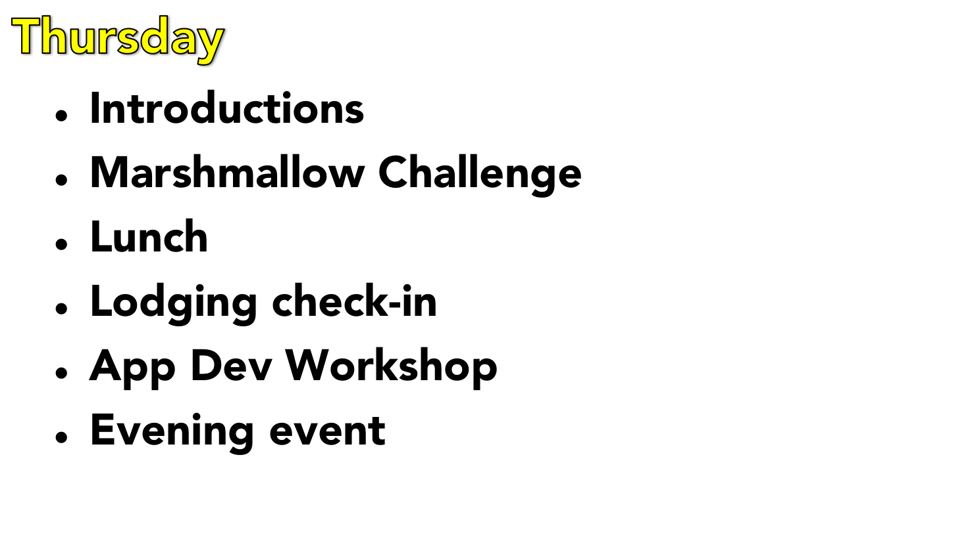

Slide 4
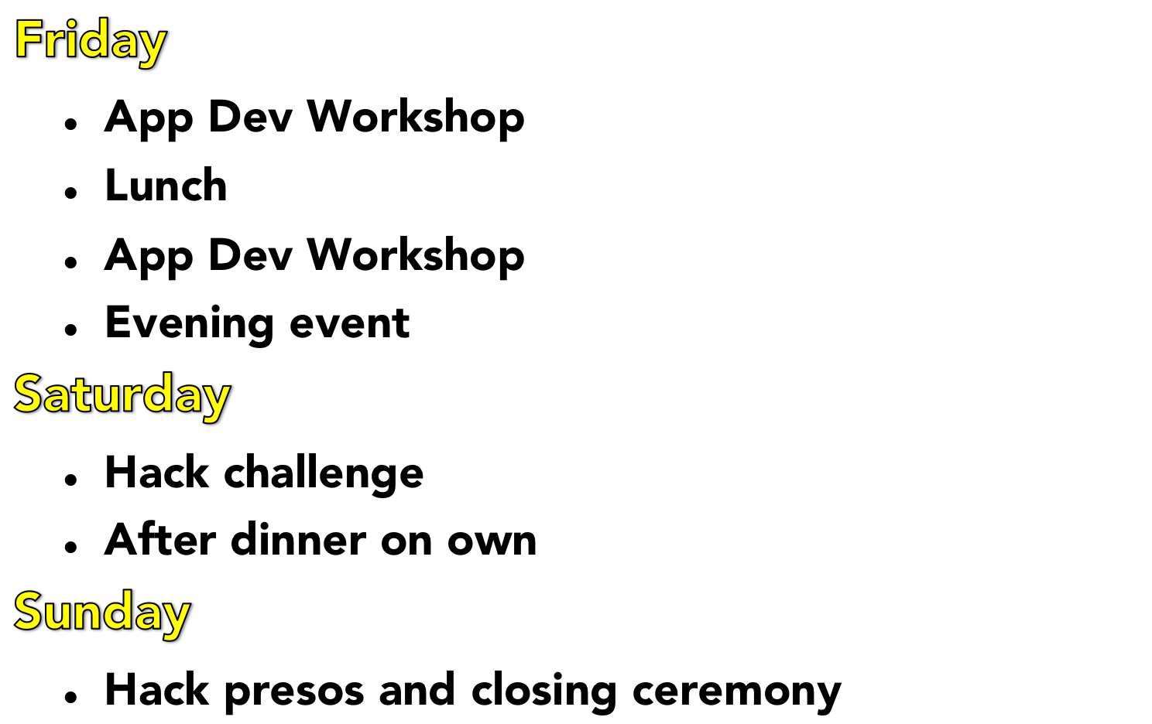

Slide 5

Dyn staff
Partners
Students
  Name
  School You Attend
  Hometown
  Your 5 strengths

Slide 6

Form teams of 3-4
Develop an app to present Sunday morning
Prepare a short presentation (5 min or so)
Win a fabulous prize and bragging rights

Slide 7
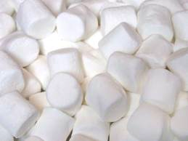
MARSHMALLOW CHALLENGE

Slide 8
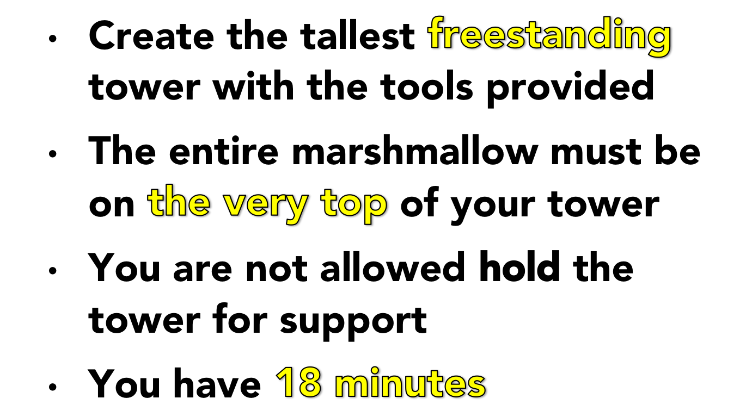
THE
CHALLENGE...

Slide 9
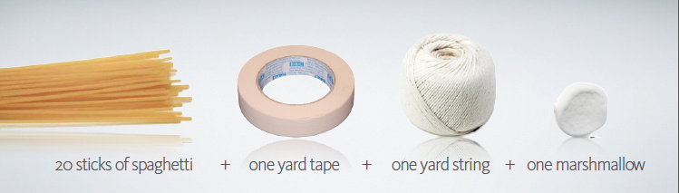
THE
TOOLS...

Slide 10
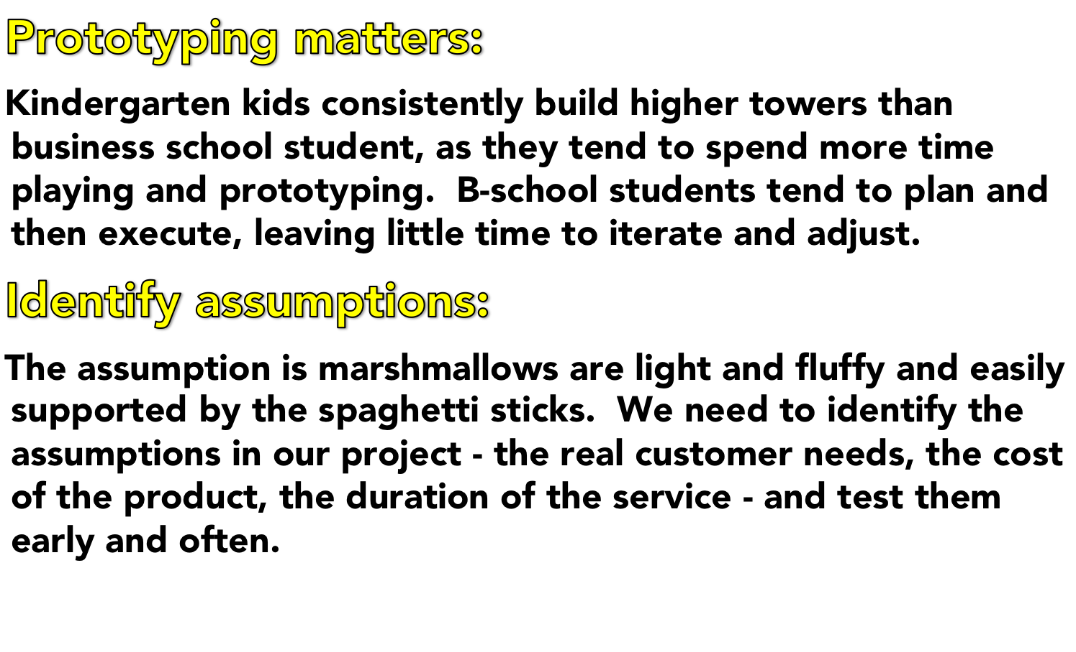
THE
Key Lessons...

Slide 11

Southern New Hampshire University
  East Side Dorm, Hampton Hall
  “Pods” 6-person area, 2-showers
  Room assignments given upon check-in
  BE BACK AT DYN

Slide 12



Slide 13

Manchester Fisher Cats vs. Portland Sea Dogs Baseball Game
  AA Affiliates of the Toronto Blue Jay's and Boston Red Sox
  “Dinner in the Den”; BBQ Dinner, Left Field
DEPART DYN @ 6:15

Slide 14

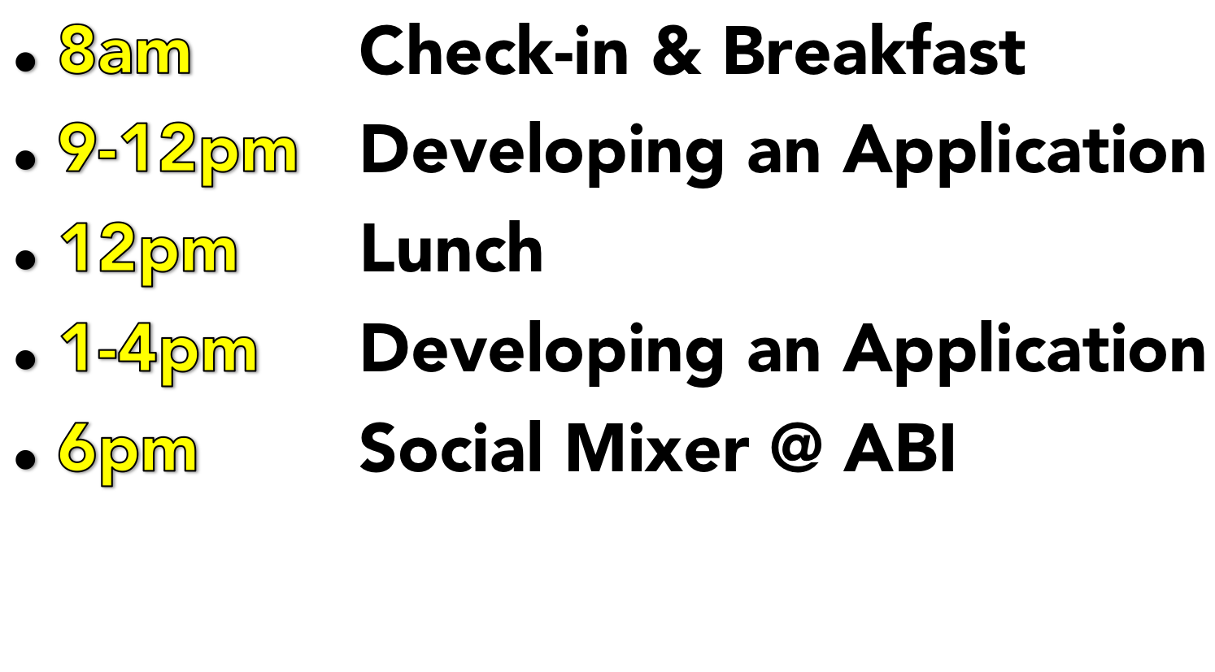

Slide 15
Team of 3-4
Develop an app to present Sunday morning
  Check code into github account
Prepare a short presentation (5 min or so)
Demo the app
Judging
  Judge’s award
  People’s Choice award

Slide 16
Judging Criteria
  Novelty of idea and how it helps people
  Does the app do what it's supposed to do
  Incorporation of Workshop concepts/learning into the development process
  How polished is product from quality standpoint (feature completeness)

Slide 17
Presentation
  Describe the app and it’s purpose
  Highlight the concepts and learning from the Workshops you incorporated into your process
  How you divided up the roles on the team
  What your biggest tech hurdle and how you addressed it
  DEMO the product

Slide 18


Slide 19

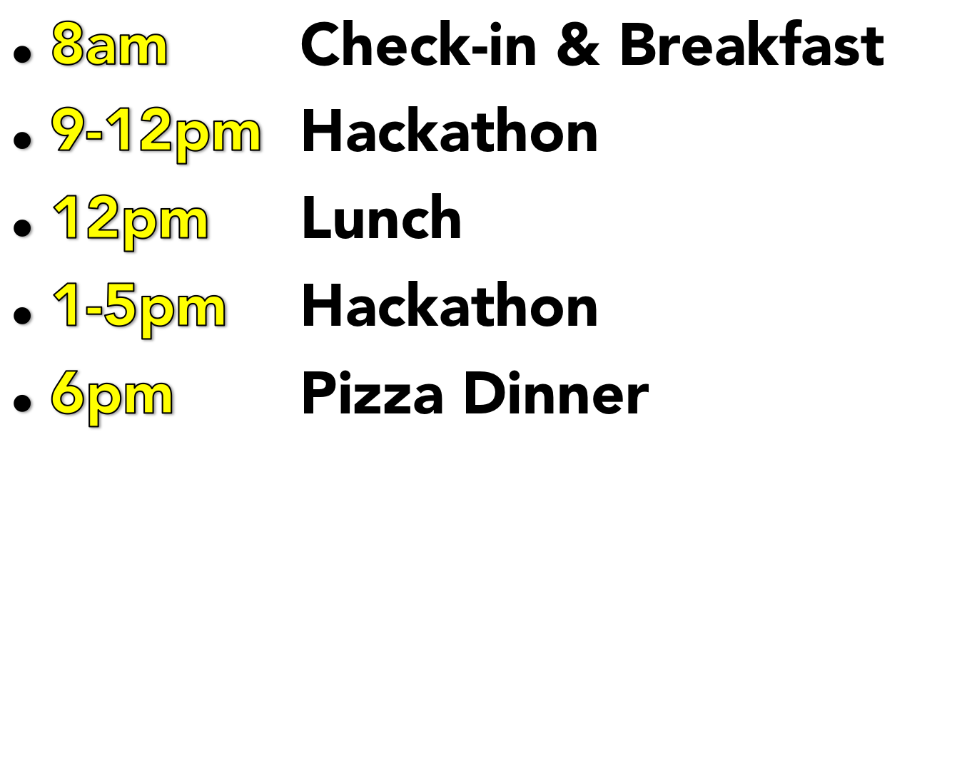

Slide 20

